Slide 1
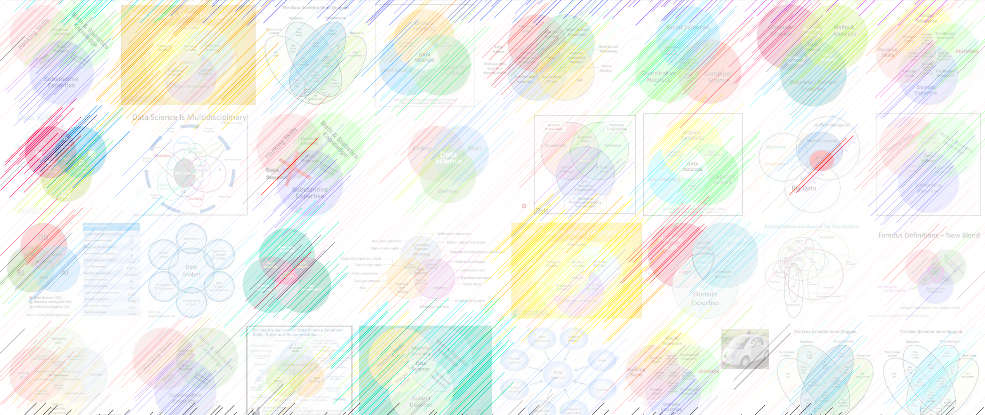

16. k-means
CS-Stat 119, Intro to Data Science II

Slide 2
Midterm project
If you turn in a midterm project in any level of completion by Wednesday, I will turn around feedback by Thursday.

Slide 3
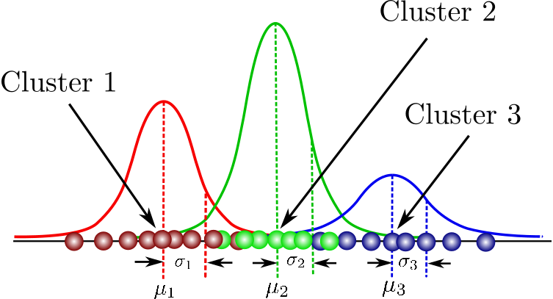
Gaussian mixture model
Easy enough to write down:
mixture coefficients π_{k}
means μ_{k}
standard deviations
or precision matrices Σ_{k}
p(x_{i}|θ) = Σπ_{k}Normal(x_{i}|μ_{k},Σ_{k})
After the sum, the class k is lost.

Slide 4
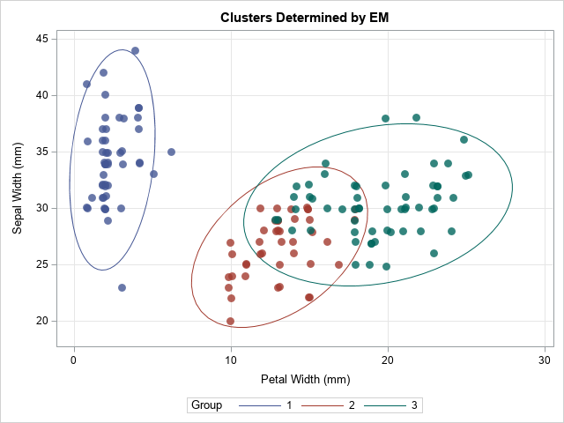
Unsupervised clustering
Task: assign labels (and a function to assign the labels) only based on data (density)
The penguins (and iris) datasets are supervised; overlapping categories from class-conditional distributions.
k-means partitions the feature space with straight-line boundaries and no labeled data

Slide 5
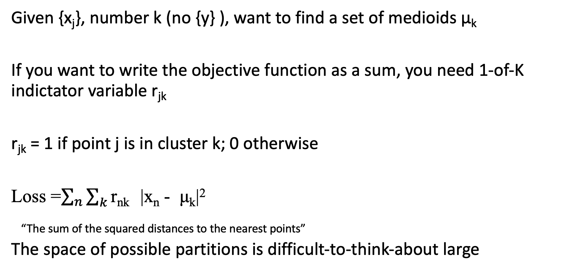
Unsupervised clustering
Given {x_{j}}, number k (no {y} ), want to find a set of medioids μ_{k}
If you want to write the objective function as a sum, you need 1-of-K indictator variable r_{jk}
r_{jk} = 1 if point j is in cluster k; 0 otherwise
Loss =$\sum_{n}{\sum_{k}{\text{r}\text{n}\text{k} } }$|x_{n} - μ_{k}|²
“The sum of the squared distances to the nearest points”
The space of possible partitions is difficult-to-think-about large

Slide 6
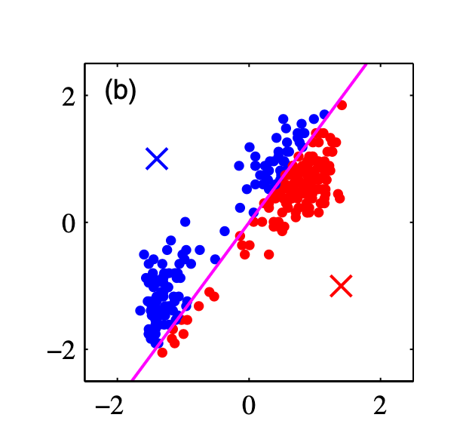
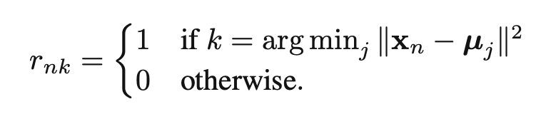
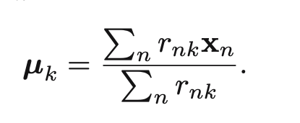
Lloyd’s algorithm for k-means
Start with k
0. Assign initial group assignments r_{nk} somehow
Find mediods corresponding to group assignments
Update group assignments given mediods
repeat 1.
assign each point to the nearest cluster
assign each cluster to the mean of the points

Slide 7
How to choose initial cluster centers for k-means?
Choose points randomly from the domain of {x} (not very good)
Choose random data points from {x} (better, default, but still not great)
Choose data points with weights that encourage widely-spaced mediods μ (kmeans ++) (better)

Slide 8
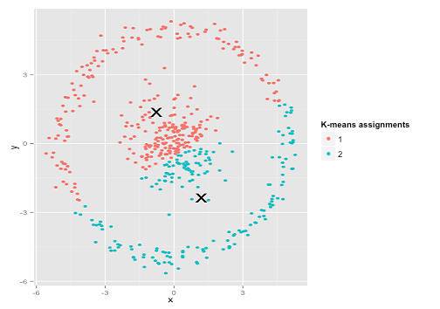
k-means headaches
Doesn’t know anything about anything; this algorithm is
as blind as PCA, but isn’t linear like PCA
Not guaranteed to converge on the optimum; unlike PCA
Lloyd’s algorithm sometimes returns different partitions
different times you run the algorithm.
There are some refinements to choose initial centers (kmeans++)
that stabilize some of the bad convergence behavior.
Doesn’t tell you anything about anything; merely generates
flimsily-evidenced clusters; it’s up to the human to find out
if the partition is meaningful or useful.

Slide 9
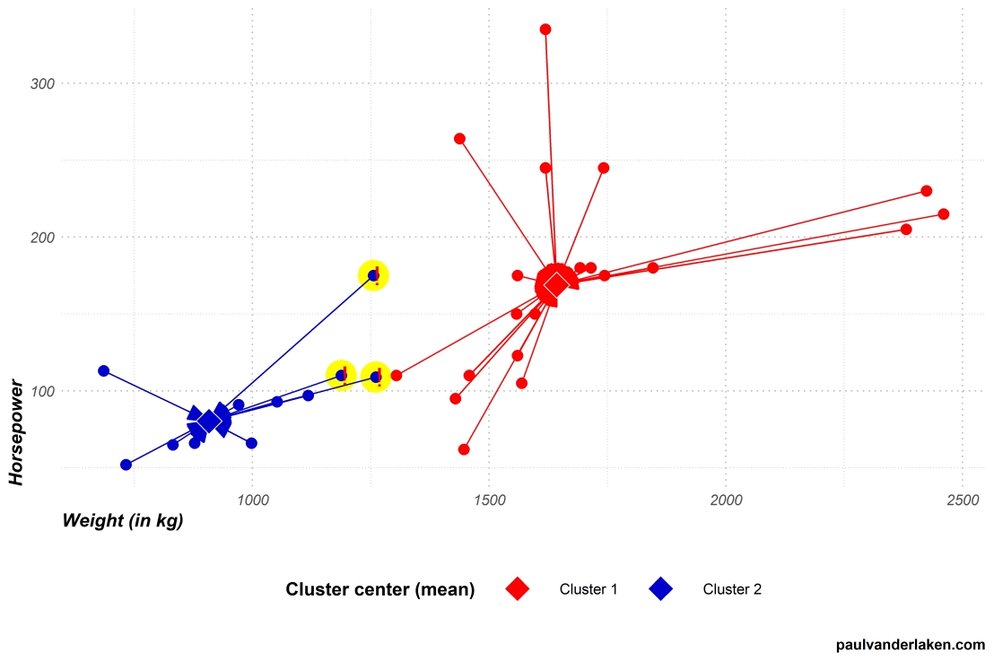
Loss function… mean squared distances from center…

Slide 10
Unsupervised clustering is for when you don’t know anything about what is happening.
In a data exploration pipeline, this is potentially a “feature augmentation” step, where the researchers are looking for regions of high data density. The correlations or logisitic regression coefficients for group membership might help tell you something about which features the clusters differ on.
Example:
lengthy audio recording of a piece of heating equipment.
equipment makes different sounds when machine A is on, machine B is on, and both A and B are on.
audio waveform-> fourier transform -> clustering -> symbols from which duty-cycle-modulation parameters can be found.

Slide 11
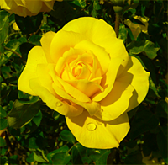
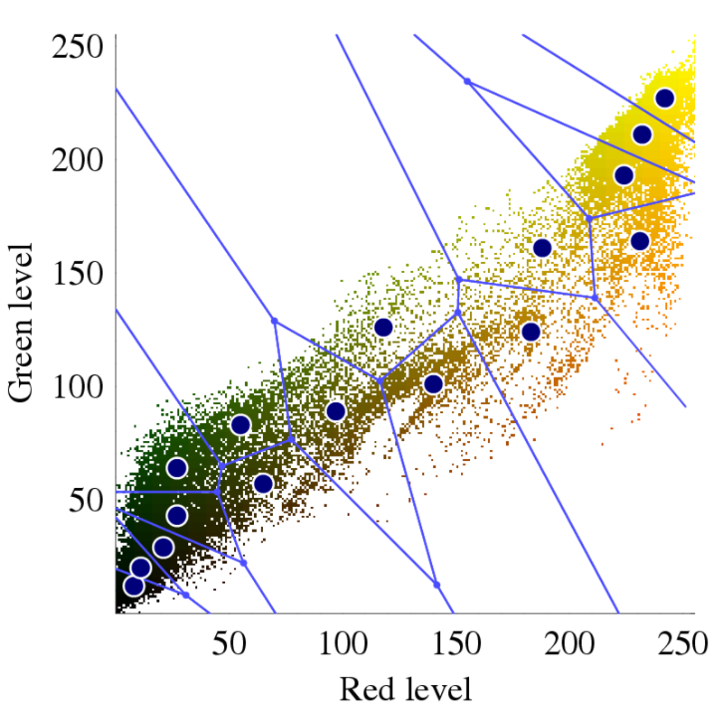
One application is selecting palletes
https://en.wikipedia.org/wiki/K-means_clustering#/media/File:Rosa_Gold_Glow_2_small_noblue.png

Slide 12
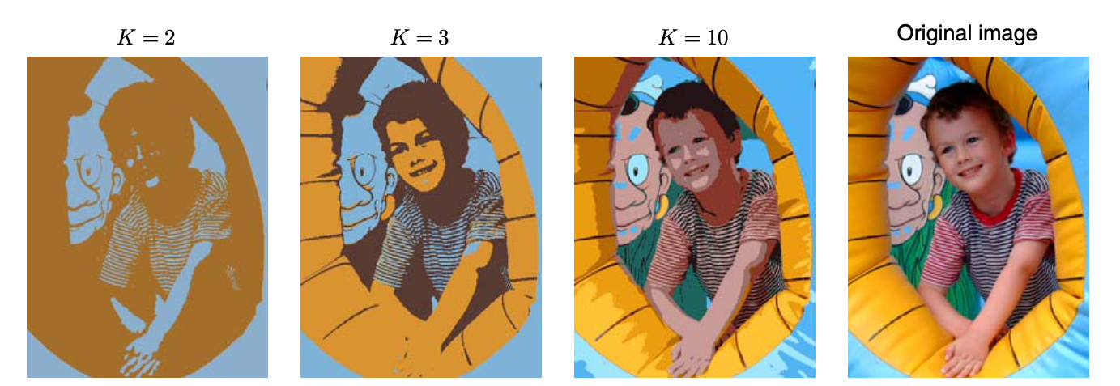
Image segmentation by color
Bishop Pattern Recognition and Machine Learning 2006

Slide 13
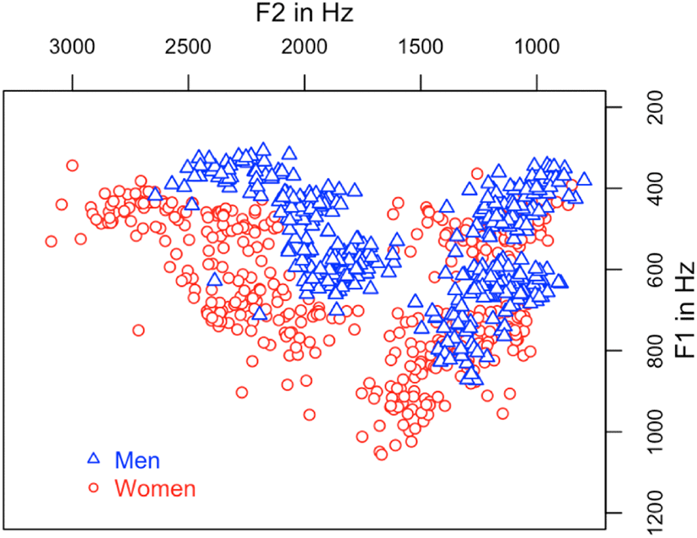
Vector quantization: turning data into symbols
Discretization of features is a workhorse of lossy data compression (audio, image, video)
Find clusters, replace them by symbols from the “codebook” and transmit the symbols instead.

Slide 14
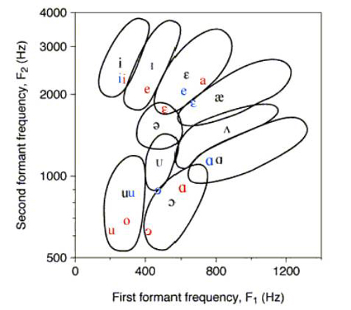
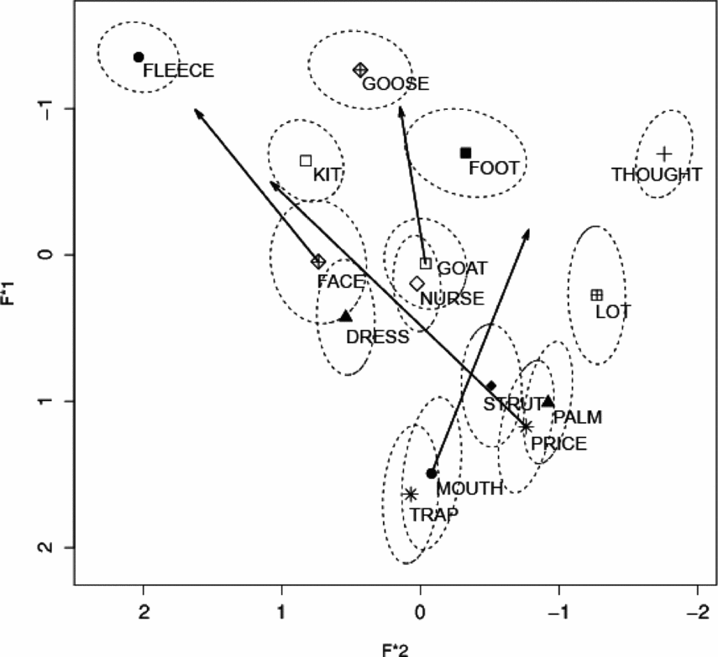
Some things are born discrete.

Slide 15
